Slide 1
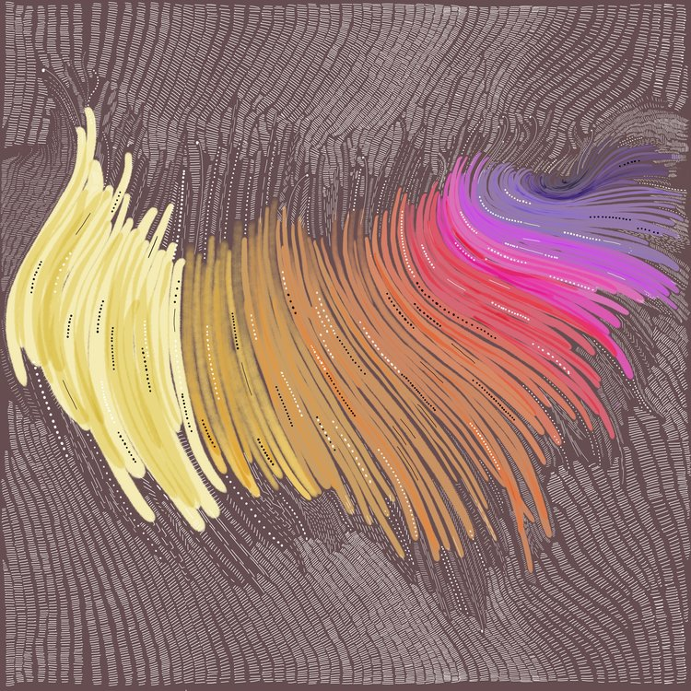
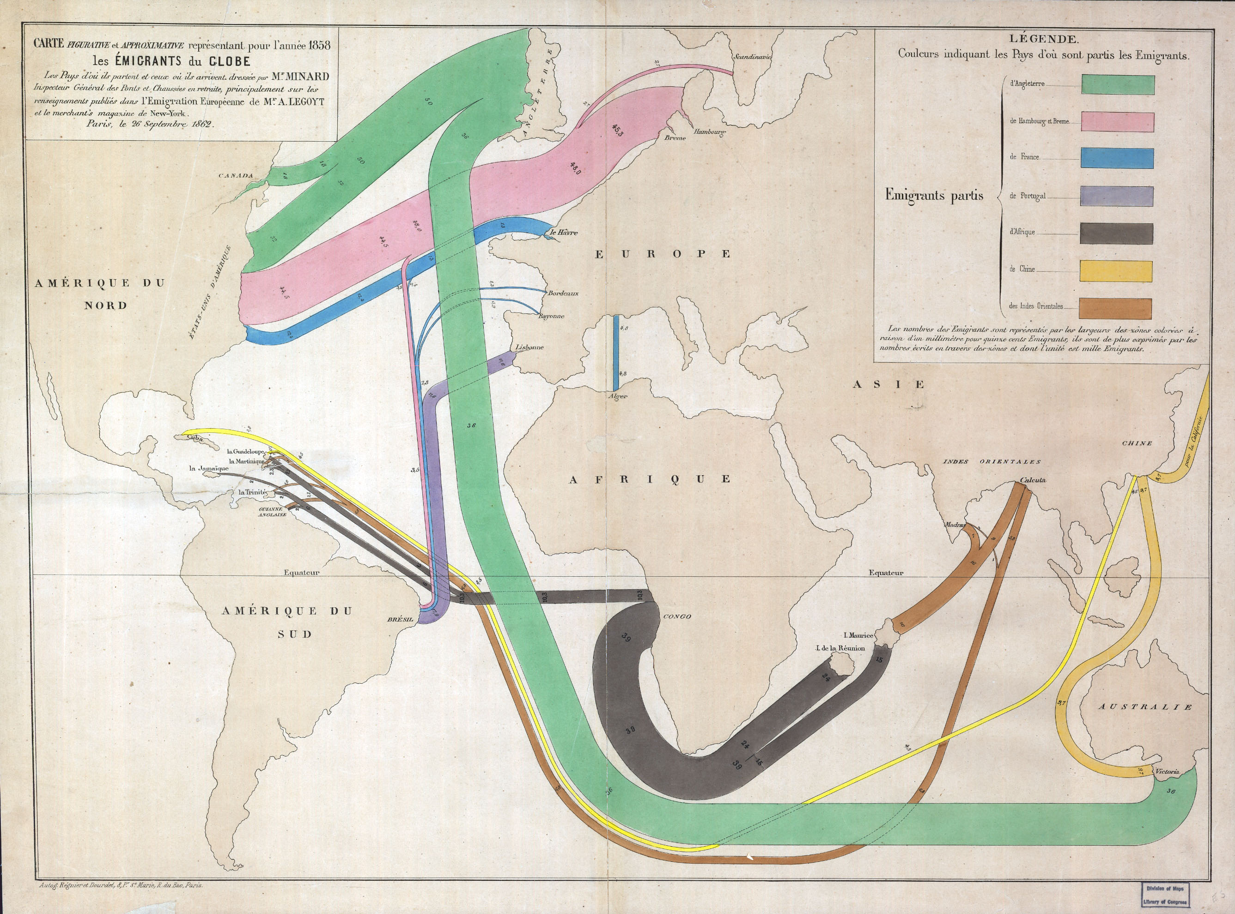
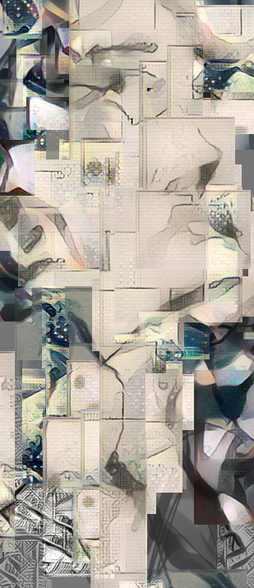
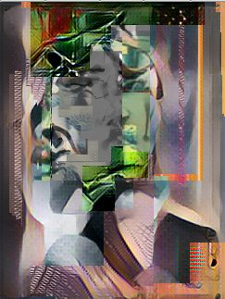
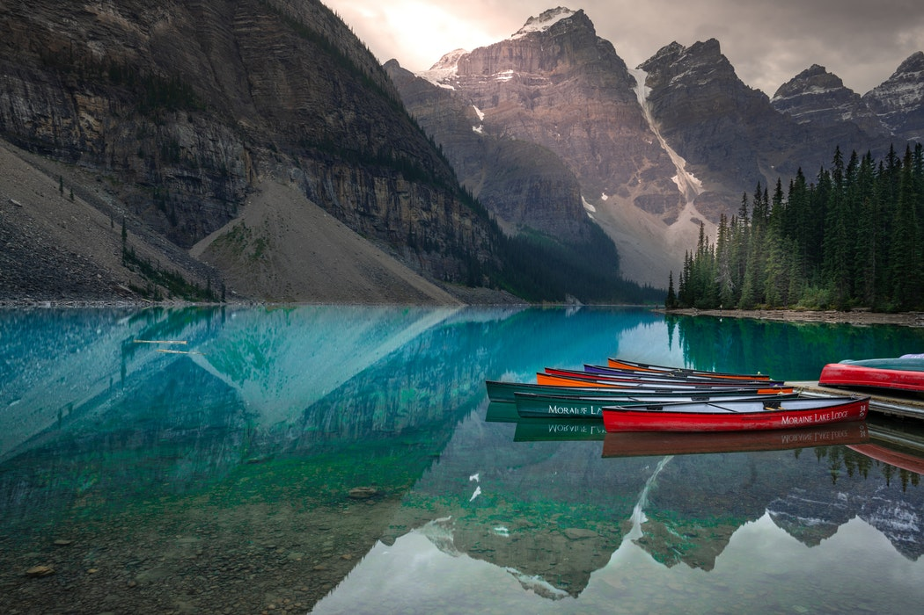
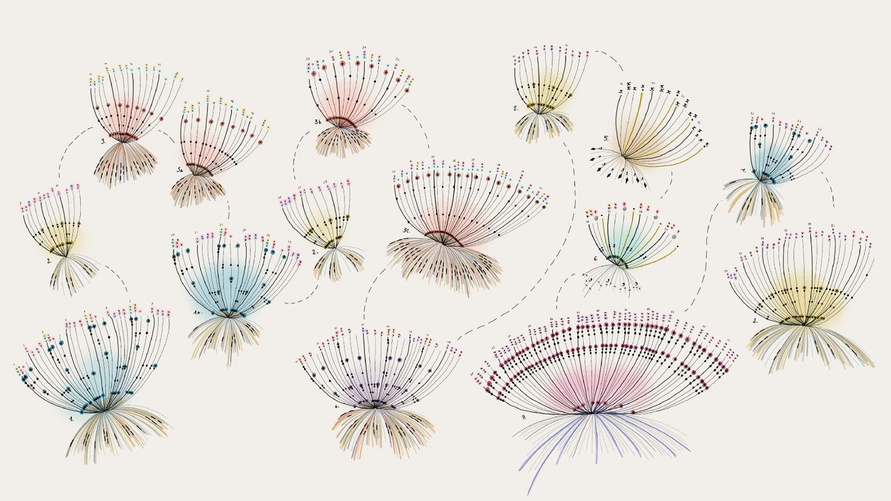
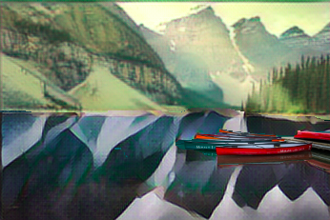
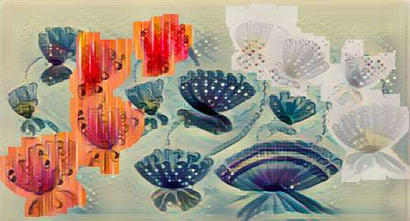
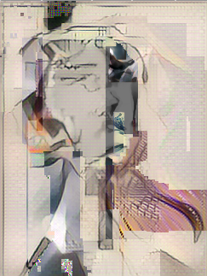
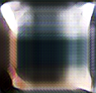
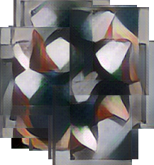
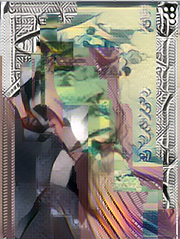
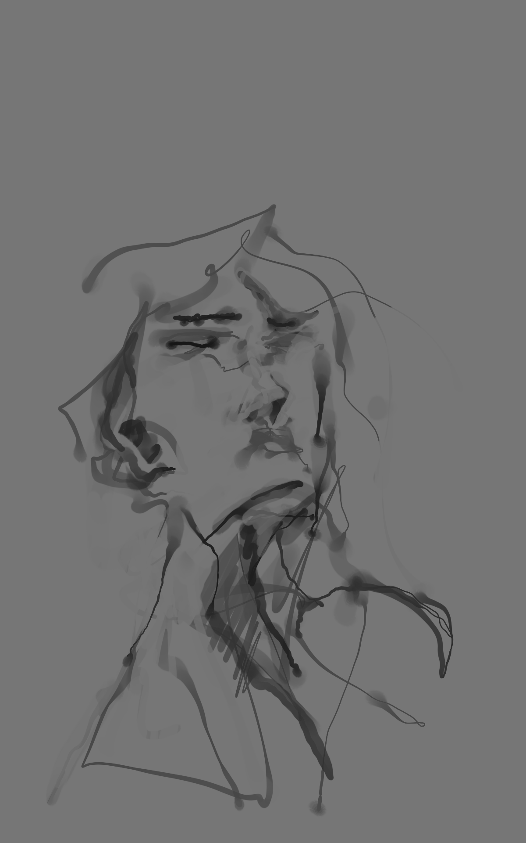
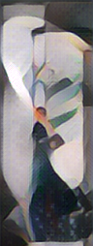
Non-Cognitive Predictors of Student Success:
A Predictive Validity Comparison Between Domestic and International Students
Non-Cognitive Predictors of Student Success:
A Predictive Validity Comparison Between Domestic and International Students
PAINTER & DATAVIS BRUSHES
We used pre-trained brushes from ml5.js, a Javascript library for web-based machine learning projects.
We also created custom brushes using famous data visualizations by Giorgia Lupi and Charles Minard.
Interactive Canvas
Style Transfer
Mahika Dubey, Jasmine Otto, Angus Forbes
UCSC Creative Coding Lab
INTRO
Our webapp applies style-transfer ‘brushes’ onto an image, allowing users to interact with deep convolutional neural networks to co-create customized art. This gives us new perspective on the learned image-to-image ‘style function’, supporting human intuition for its expressive range.
STYLE TRANSFER
All style models used in this application were produced from running a single content image input through a pre-trained 19-layer feature extractor network (VGG-19). Fast VGG architectures for deep style transfer do not train on the content image, resulting in a style transfer network which works even on unseen images. The ml5.js implementation of this architecture underlies our frontend supporting a casual creator experience.
DISCUSSION
We sought to understand the role of artistic vision in art creation. Does the artist’s intent create the content layout, or does the layout emerge according to the artist’s personal style? Thinking of style transfer inherently separates the creative process for creating an art piece into a content layout (an entire image), and an image-to-image function mimicking an existing style. The traditional roles of artist and curator are intertwined.
Paint styles onto your pictures with interactive brushes, based on visual motifs from data art.
Non-Cognitive Predictors of Student Success:
A Predictive Validity Comparison Between Domestic and International Students
Non-Cognitive Predictors of Student Success:
A Predictive Validity Comparison Between Domestic and International Students
Stamps
MAGIC MARKERS
The Magic Markers application uses natural brush interactions so that users can apply style of their choice through intuitive selection and dragging.
Brush selections on the canvas can be dragged or reshaped to reveal (‘paint’) the style applied to the user’s entire content image. Intermediate results can be styled in turn, producing layered results.
COMPOSITING STAMPS
The Compositing Stamps
app applies styles in real-time
to user-selected slices of an
image, enabling their ‘collage’
to diagnose boundary features
and other artifacts of the
content-sensitive brush.
↓
Stamps + Markers
Udnie
Francis Picabia, 1913.
Style model as
seen by VGG-19.
Base Image
Notes:
Notes:
In Powerpoint, click View > Guides
Keep text within gutter guides.
Author list: Don’t split names onto two lines (e.g., “Jimmy [break] Smith”). If that happens, use a new line, unless you need the space. Bold the first names of anybody who’s presenting in person.
Intro/methods/result: Do not drop below font size 28, but if you have extra space, jack up the font size until the space is full.
Do not use color in the sidebars except in graphs/figures. It’ll pull attention from the center and slow interpretation for passersby.
<number>

